Slide 1
Vehicle cut-in detection
Using IDD (Indian driving data)

Slide 2
Definition of a cut-in scenario
Figure 1 shows a bird’s eye view of a cut-in situation as it is addressed in this work.
The boxes represent vehicles heading in x-direction.
In the scenario pictured, the ego vehicle follows F1, the first car in front of it and F2, the car in front of F1.
The vehicle to the left of the ego vehicle, marked Le, wants to perform a lane change and position itself in front of the ego vehicle.
This action is referred to as a cut-in throughout this work. The moment the “Le” car’s centre passes the lane marker to the left of the ego vehicle is taken as the instance of the event happening.

Slide 3
1. Project goal and functionality:
Detection only ? The system just detects cut-in events and raises an alert (visual or audio)
Collision Avoidance? The system additionally estimates potential collisions and initiates actions like breaking (for autonomous vehicles).
2. Technical approach:
Vision-based: use a camera to capture video and employ computer vision techniques for object detection and tracking. This is the most common approach
LiDAR-based system with Computer Vision:
This is a good starting point for a project Here’s a simplified workflow
Tools:
Simulation and coding environment: we’ll use Matlab softwere for this simulation. Apps like Simulink and vehicle Automation will be helpful for creating visuals.
We are using Indian driving dataset (IDD) in our project to simulate more realistic driving scenarios and enhance the detection of cut-in events. The Indian driving dataset is used to model traffic behaviours , vehicle dynamics, and environmental conditions specific to Indian roads.
We are also using Rasbeypi with Python coding.

Slide 4
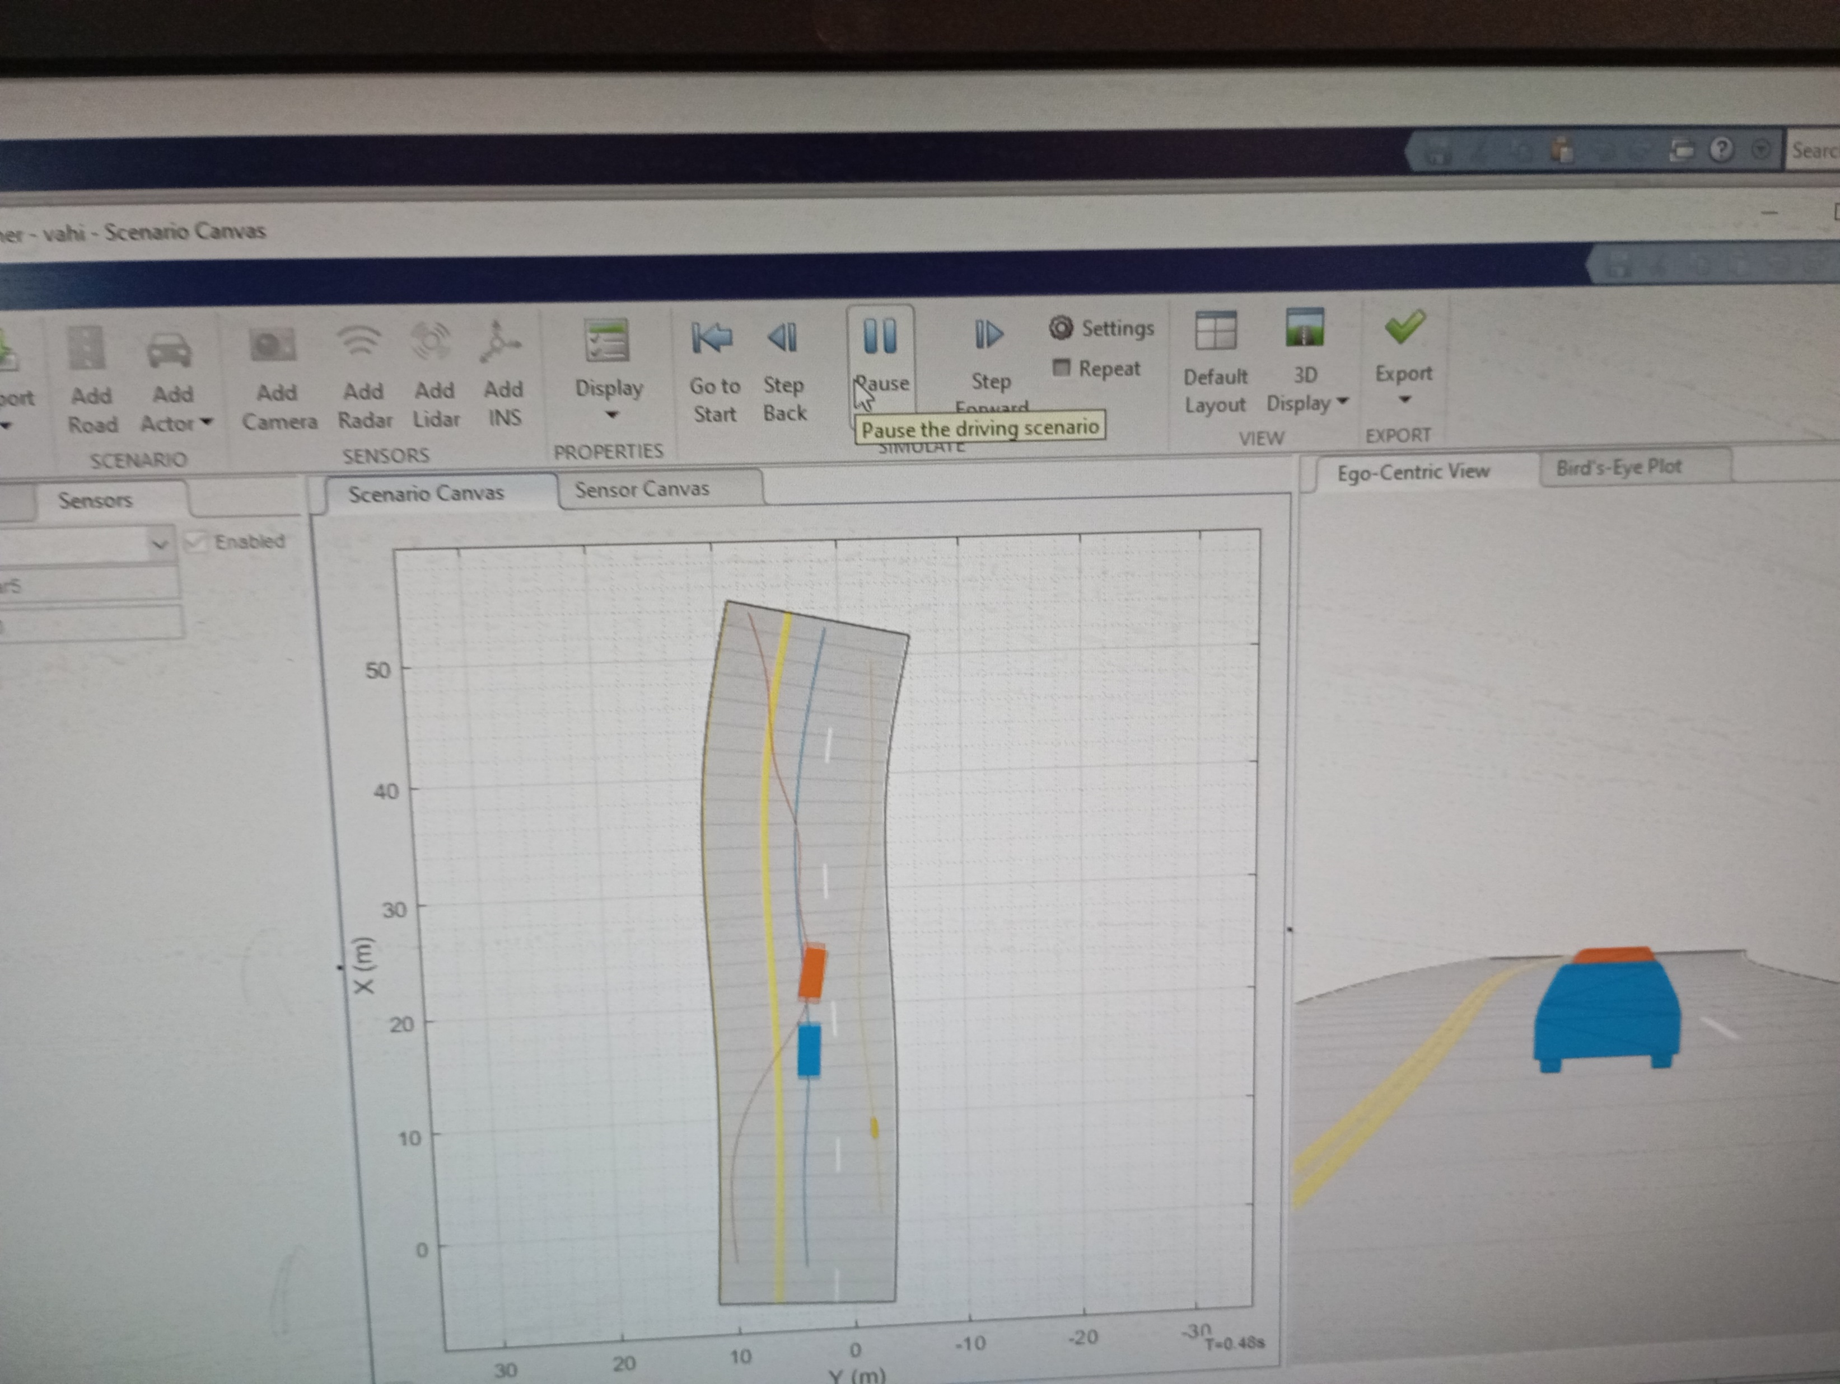
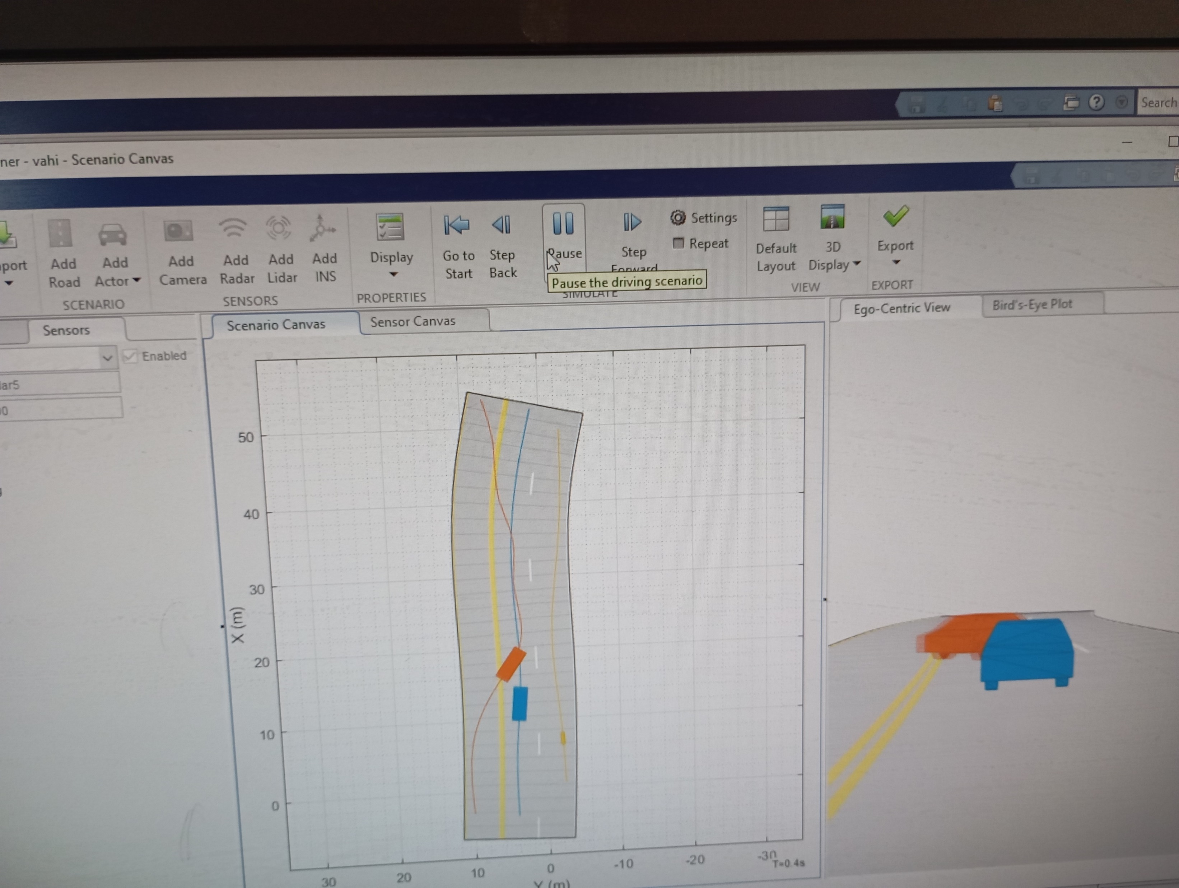
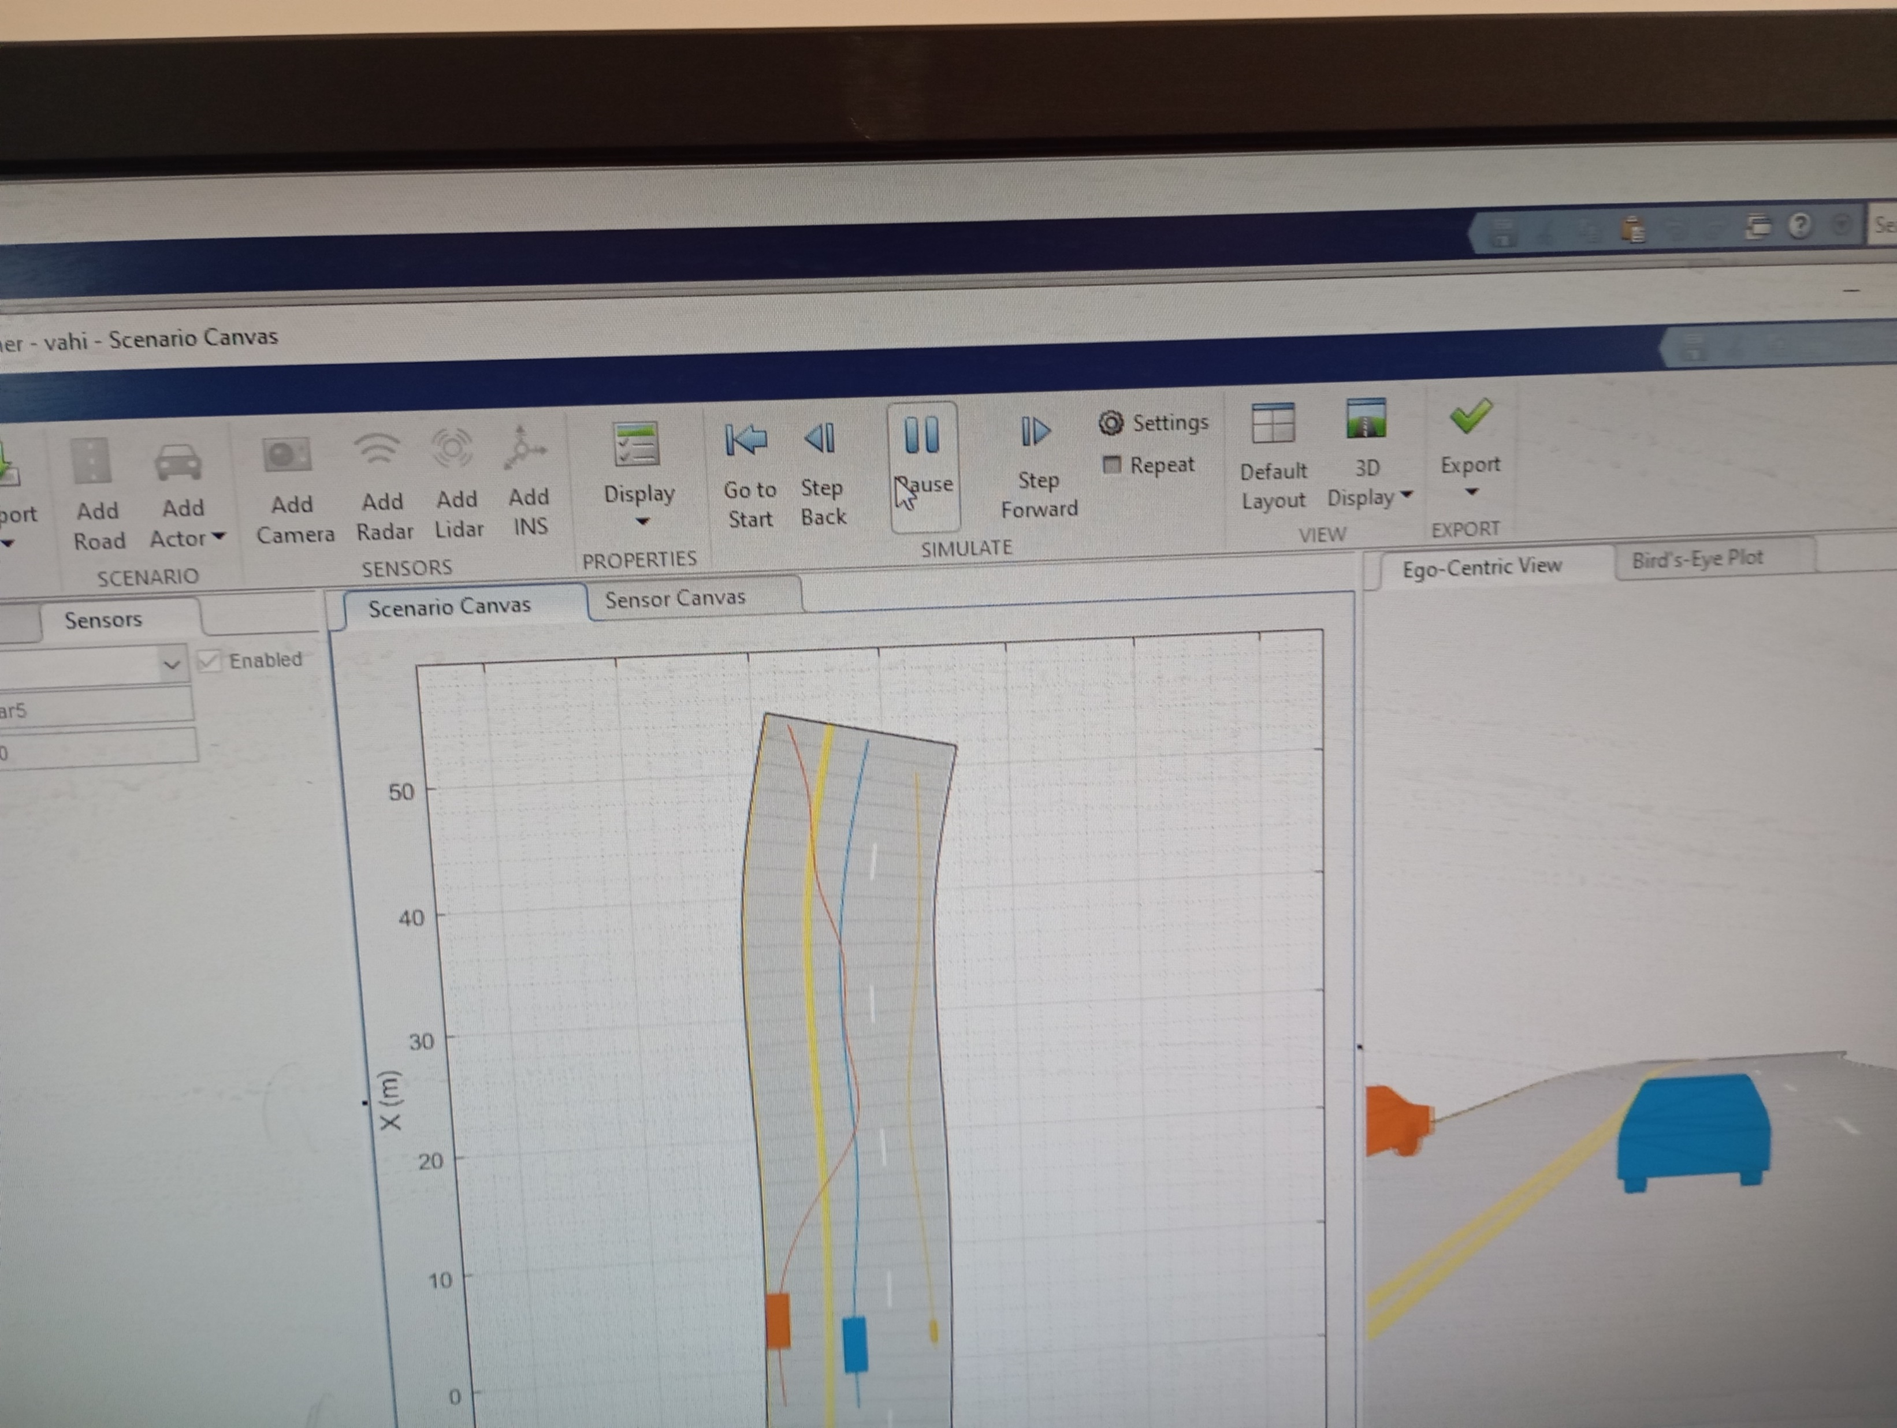

Slide 5
Python script
import tensorflow as tf
import numpy as np
import cv2
from picamera.array import PiRGBArray
from picamera import PiCamera
# Load the trained model
model = tf.keras.models.load_model('vehicle_cutin_model.h5')
# Initialize the camera
camera = PiCamera()
camera.resolution = (640, 480)
camera.framerate = 32
rawCapture = PiRGBArray(camera, size=(640, 480))
# Allow the camera to warmup
import time
time.sleep(0.1)

Slide 6
# Define a function to preprocess the image
def preprocess_image(image):
image = cv2.resize(image, (224, 224)) # Resize image to match model's expected input
image = image.astype('float32') / 255.0 # Normalize pixel values
image = np.expand_dims(image, axis=0) # Add batch dimension
return image
# Start capturing frames
for frame in camera.capture_continuous(rawCapture, format="bgr", use_video_port=True):
image = frame.array
# Preprocess the image
processed_image = preprocess_image(image)
# Predict using the model
prediction = model.predict(processed_image)
# Check if there is a cut-in
if prediction[0][0] > 0.5: # Assuming binary classification with sigmoid activation
print("Vehicle cut-in detected!")
# Add additional actions here, like sending alerts

Slide 7
# Clear the stream in preparation for the next frame
rawCapture.truncate(0)
# Display the frame (optional)
cv2.imshow("Frame", image)
key = cv2.waitKey(1) & 0xFF
if key == ord("q"):
break
# Cleanup
cv2.destroyAllWindows()
camera.close()

Slide 8

% Load the pre-trained model
net = load('vehicle_cutin_model.mat'); % Assuming the model is saved in .mat format
% Initialize the Raspberry Pi connection
rpi = raspi();
cam = cameraboard(rpi, 'Resolution', '640x480', 'FrameRate', 30);
while true
% Capture image
img = snapshot(cam);
% Preprocess the image
img = imresize(img, [224 224]);
img = double(img) / 255; % Normalize pixel values
% Predict using the model
prediction = predict(net, img);
% Check if there is a cut-in
if prediction(1) > 0.5 % Assuming binary classification with sigmoid activation
disp('Vehicle cut-in detected!');
% Add additional actions here, like sending alerts
end
% Display the image (optional)
imshow(img);
drawnow;
end

Slide 9
Thank you

